Slide 1
Points to profit
Q4 2021

Slide 2
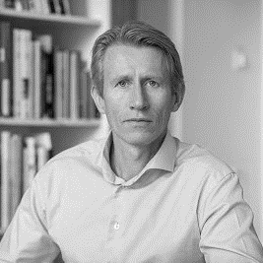
Today’s presenter
Niklas Lundqvist
CEO
Founder and member of the Board of Directors since 1999
Bachelor of Laws and LLM, Uppsala University and Maastricht University Economics Gothenburg School of Business, Uppsala University

Slide 3













Awardit in brief
BROAD OFFERING TO CATER ALL NEEDS
ATTRACTIVE FUNDAMENTALS FUELING GROWTH AGENDA
<
<
Strategy & Concept
Largest company and platform for loyalty-, incentive- and gift card programs in the Nordics. Provided continued strong organic growth 1bn is within reach 2022!
Design & UX
Our vision is to become one of the absolute leaders in our industry on the European market. On our journey we will continue to help build better customer relationships and to increase the value of customer data not only for businesses but also for their customers.
SaaS-platform
SaaS-toolbox that covers all parts of the loyalty- incentive- and gift card program value chain
Partnerships
+250 programs reaching more than 15 million consumers
Strong organic growth and rising profitability
Loyalty marketplace
Two business areas; Loyalty & Gift cards
Customer support
10 completed acquisitions since IPO in Dec 2017.

Slide 4
FY 2017-2021 IN BRIEF
CURRENT PIPELINE SUPPORTS ACCELERATED GROWTH
UNDISPUTABLE EARNINGS GROWTH
Revenue
SEK million
EBITA
Margin
EBITA
Per share
EBITA
SEK million
1
Exclusively organic growth until 2017
1
Profitable growth adding EBITA per share. 2021 EBITA was 93,2m. 149% growth of which 32% organic.
2
M&A and organic growth from 2018 and forward
2
Increased gross margins and EBITA-margins over time
2020 revenue adversely impacted by the pandemic. 2021 back to high growth, 89% of which 24% organic, but some areas are still behind vs 2019. Revenue was 529m.
3
3
Proven highly scalable business model

Slide 5
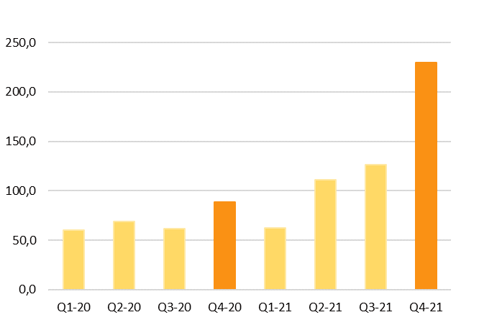
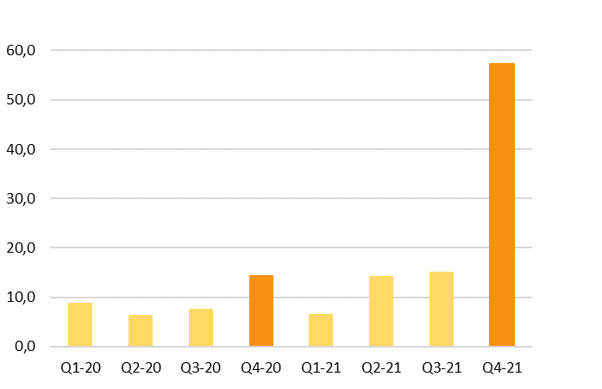
Q4 - REVENUE GROWTH IS REACCELERATING TO NEW LEVELS
QUARTERLY ACCELERATING REVENUES
EBITA DEVELOPMENT
<
+160%
+296%
<
Revenue
SEK million
160% growth of which approx. 43% organic
MBXP picked up during Q4 generating 52,6m. Prior poor performance due to covid was neutralized by retroactive state covid support of 14,2m of which 8,9m was recognized as group revenue in Q4. TIC 26,3m. Prämie 24,6m.
296% EBITA growth of which approx. 41% organic
MBXP contributed 25,5m, TIC 5,8m and Prämie 5,4m in EBITA.

Slide 6
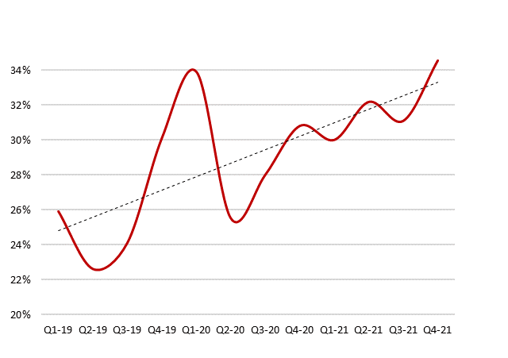
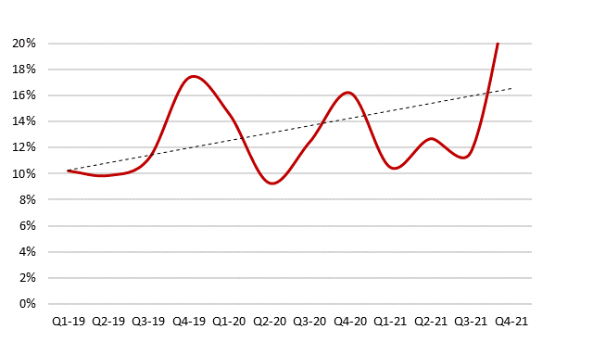
GROSS MARGIN ON THE RISE WITH PROFITABILITY ON THE INCREASE
GROSS MARGIN DEVELOPMENT
STEADILY INCREASING EBITA MARGIN SOON TO ENJOY BREAKAGE
Gross profit
Margin
EBITA
Margin
1
Positive trend over time, both Gross Margin and EBITA
2
B2B sales with higher gross margin representing a growing share of total sales.
3
Zupergift breakage stabilizing and moving along with surging sales volumes. Total FV-value sales approx 100m 2021. Breakage was approx 3,8m in Q4 and 4,4m in total 2021.

Slide 7









Awardit IPO
Acquisition of
Crossroads Loyalty Solutions AB
Acquisition of
Market2member AB
Acquisition of
Motivation Service AB
Acquisition of
Retain 24 Sverige AB
Acquisition of
The Inspiration
Company AB
Dec-2017
Jan-2018
April-2018
Nov-2018
Okt-2019
Nov-2019
Dec-2019
March-20
April-21
June-21
Dec-21
Acquisition of Sponsorhuset AB
Acquisition of remaining shares in Rewardit AB
Acquisition of assets Goyada AB
Acquisition of MBXP ApS
Acquisition of Prämie Direkt GmbH
Source: Company information.

Slide 8

CUSTOMER ACQUISITION STRATEGY
TARGET AUDIENCES
DRIVING FORCES FOR OUR CUSTOMERS
<
<
LOYALTY& GIFTCARD PROGRAMS
Consumers
Businesses
Resellers
Employees
Achieve a greater ”share of wallet”
Reduce price and discount focus
Increase customer lifetime and reduce churn
Establish a more responsive and cost-effective customer communication
Offer attractive value-add services
Stimulate own personnel or reseller through rewarding results, activity, competency and engagement
Source: Company information.

Slide 9











EXPOSED TO MASSIVE GLOBAL MARKETS
STABLE DOUBLE DIGIT GROWTH
DIGITAL LOYALTY PROGRAM GROWTH UNDERPINNED BY DIGITAL TRANSITION
<
<
Global Gift Card Market in billion USD
Global Loyalty Program Market in billion USD
CAGR 16.2% 2020-2027E
CAGR ~5% 2018-2022E
The expanding adoption of smartphones is expected to increase the gift card market by offering flexible payment methods for customers
Outsourcing the reward program comes with strong cost benefits related to expensive technology platform
  Modern technology has created ways for smartphone users to integrate everything in one convenient package
The growing footprint of the adoption of loyalty program strategy by buyers indicate the willingness of both the supplier and buyers to partner on a global scale
  Environmentally friendly driven shift from plastic to digital gift cards contributes to a more flexible product
Growth in online buying culture and high adoption of smartphones has raised the need for a digital loyalty program strategy
Source: alliedmarketresearch, Beroenic
Notes:
Source:
https://www.alliedmarketresearch.com/gift-cards-market
https://www.beroeinc.com/category-intelligence/loyalty-programs-market/

Slide 10










Business model
ATTRACTIVE OFFERING YIELDING LONG-TERM VALUE CREATION FOR AWARDIT’S CUSTOMER
Loyalty
Gift Cards
Partnerships
Set-up fees
Set-up fees
Commissions
Monthly fees
Monthly fees
Sale of points
Loading fees
Sale of points
Campaign fees
Commissions
Loyalty marketplace
Breakage (private labels)
Expert Service
Expert service
Extensive customer portfolio
Source: Company information.

Slide 11


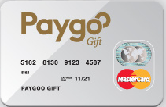

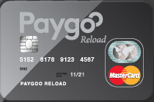



PRIVATE LABELS

Slide 12


WELL POSITIONED FOR CONTINUED SUCCESS
Integration of TIC 50% done. Prämie project initiated to identify procurement savings and cross selling opportunities.
Continued strong organic growth . 54% in January.
Continued work on business oriented synergies (cross selling) within the group. Launch of Zupergift on additional markets.
Continued establishment of partnership network based on Open Banking / Account & Card linking
Steady flow of new customers – especially within the Giftcard segment. Best pipe ever in general.
Additional value creating acquisitions. Cash position of approx. 240m at years end provides buying power.
Vision to become one of the absolute leaders on the European market.
Notes:
Ingen ändring på denna slide 2019-09-11.

Slide 13



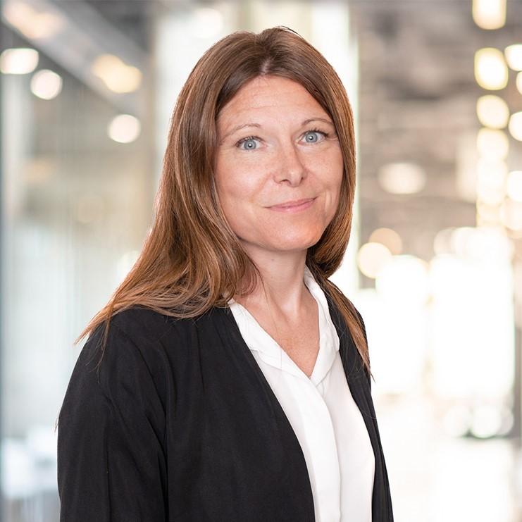
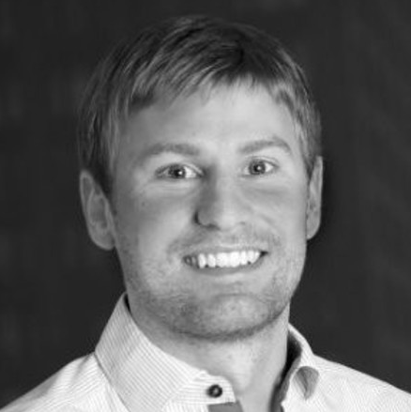
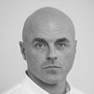
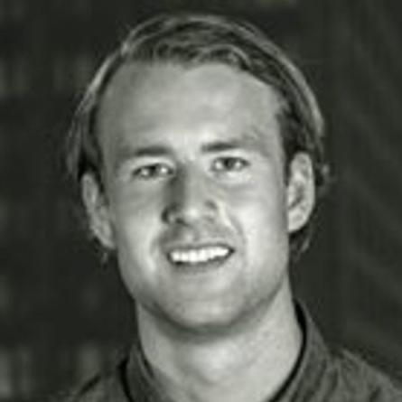
Management team
Niklas Lundqvist, CEO
Founder and member of the Board of Directors since 1999
Bachelor of Laws and LLM, Uppsala University and Maastricht University Economics Gothenburg School of Business, Uppsala University
1 111 550 shares
Anders Svanberg, Loyalty B2C Business Area Manager
Employed and member of management team since 2018
Lux Business School, Business Administration at Stockholm University
24 232 shares
Mattias Lundqvist, Giftcards Business Area Manager
Employed since 2013
Industrial Economics, Chalmers and the Universidad Politécnica de Madrid
20 752 shares
Ulrik Zielfelt, Sales & Marketing Manager
Employed since 2019
MSc in Economics, Gothenburg School of Business
20 000 shares
Cecilia Ponthan, CFO
Employed since 2022
Business IT, Nackademin
0 shares
Christian Lindholm, CIO
Employed since 2021
Master of Business Administration, Gothenburg School of Business, Bachelor of Information Technology, Halmstad University and Unitec Institute of Technology, Auckland
0 shares
Johan Hagman, Loyalty B2B Business Area Manager
Employed since 2001
Master of Statistics and Bachelor of Investigative Sociology, Stockholm University
339 612 shares
Jonas Sjögren, CPO
Employed since 2015
Purchasing, Institute of Business Administration
0 shares

Slide 14
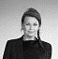
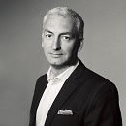
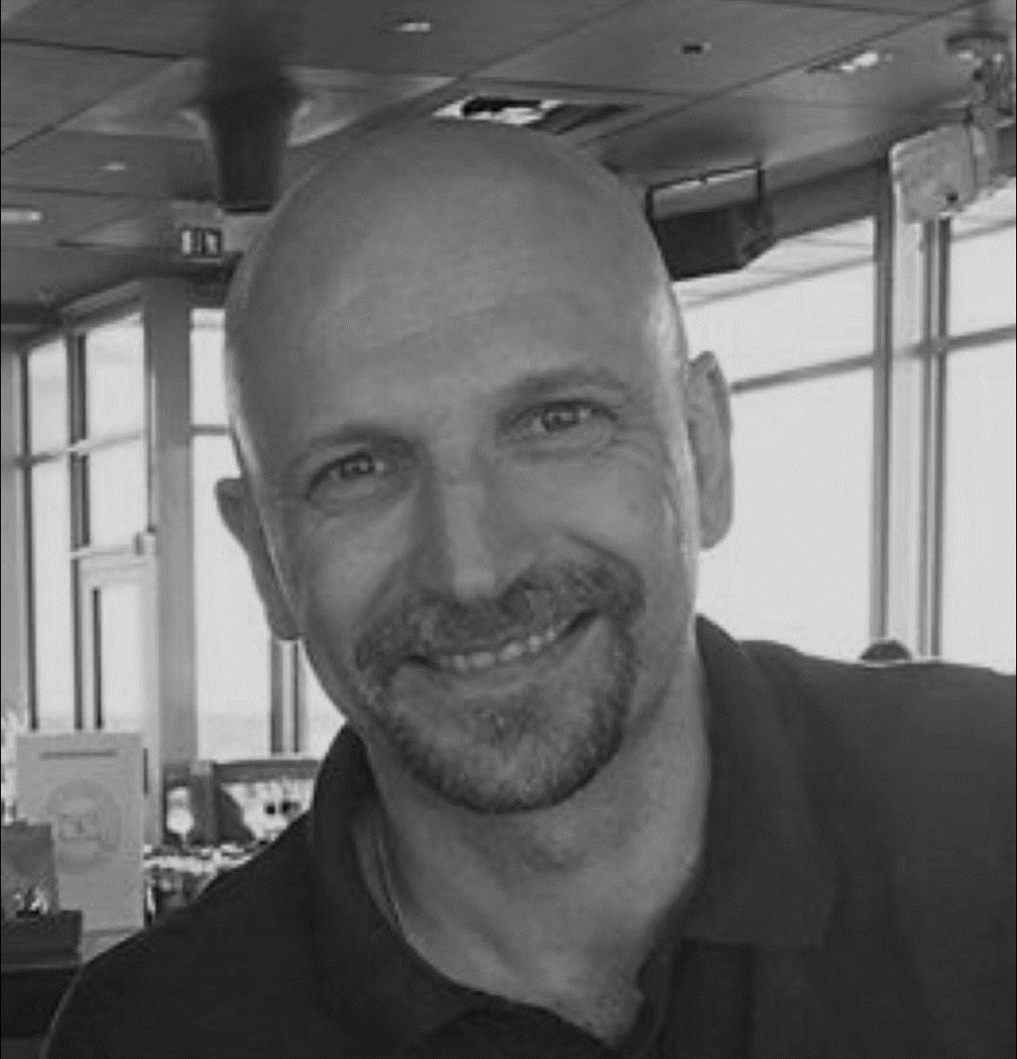
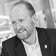
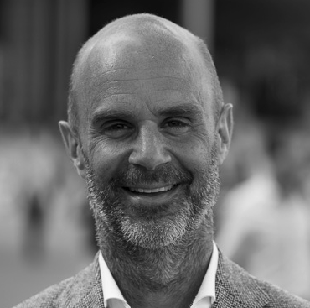
Board OF DIRECTORS
Niklas Lundqvist, Member Board of Directors
CEO, founder and member of the Board of Directors since 1999
Bachelor of Laws and LLM, Uppsala University and Maastricht University Economics Gothenburg School of Business, Uppsala University
1 111 550 shares
Charlotte Eisner, Member Board of Directors
Member of the Board of Directors since 2017
Master of Science in Business Administration, School of Business, Economics and Law at the University of Gothenburg
0 shares
Samir Taha, Member Board of Directors, Chairman
Member of the Board of Directors since 2000
MSc in Economics, Uppsala University
320 519 shares
Claudio Simatovic, Member Board of Directors
Member of the Board of Directors since 2020
Founder and previous CEO of several companies including Retain24 Sverige AB
132 211 shares
Olle Isberg, Member Board of Directors
Member of the Board of Directors since 2002
Stockholm School of Economics, Stockholm
2 100 000 shares
Peter Borsos, Member Board of Directors
Member of the Board of Directors since 2020
Economics Master of Economics (Örebro University, Freie Universität Berlin and University of Massachusetts)
49 000 Shares

Slide 15
Largest Shareholders dECEMBER 30, 2021
Shareholder | Shares | % Ownership | % Votes
Visionalis AB | 2 090 000 | 25,1% | 25,1%
Niklas Lundqvist | 1 111 550 | 13,3% | 13,3%
Consensus Asset Management AB | 405 425 | 4,9% | 4,9%
Johan Hagman | 339 612 | 4,1% | 4,1%
Samir Taha (gm Sultanen Invest AB) | 325 000 | 3,9% | 3,9%
Filip Engelbert | 242 653 | 2,9% | 2,9%
Jonas Nordlander | 242 652 | 2,9% | 2,9%
S Thorberg Inspiration Investment Ltd | 196 331 | 2,4% | 2,4%
Claudio Simatovic (gm Paradidel AB) | 132 211 | 1,6% | 1,6%
Fredrik Landgren | 120 388 | 1,4% | 1,4%
Other shareholders | 2 563 066 | 37,5% | 37,5%
Total | 8 335 518 | 100.0% | 100.0%
Source: [Euroclear per 2021-12-30]
Notes:
Korrad och klar /RJ 11 nov

Slide 16
Income statement
SEK thousand | Q4’21 | Q4’20 | 2021 | 2020
Revenue | 229,534 | 88,404 | 529,319 | 278,613
Activated work for own account | 471 | - | 3,021 | 194
Other operating income | 16,214 | 458 | 19,387 | 1,717
Total operating income | 246,219 | 88,862 | 551,727 | 280,524
Operating expenses
Merchandise | -150,233 | -61,194 | -356,273 | -196,350
Other external costs | -18,512 | -2,656 | -38,474 | -11,771
Personnel costs | -19,757 | -10,369 | -62,925 | -34,603
D&A | -13,199 | -1,929 | -30,083 | -7,519
Other operating costs | -129 | -175 | -464 | -399
Total operating expenses | -201,830 | -76,323 | -488,219 | -250,643
Operating result | 44,389 | 12,539 | 63,508 | 29,881
Financial income | 548 | 2 | 601 | 27
Financial costs | -14,263 | -466 | -23,700 | -2,190
Results from units in the group and associated companies | -273 | - | -236 | -
Net result from financial items | -13,988 | -464 | -23,336 | -2,163
Profit before tax | 30,401 | 12,074 | 40,172 | 27,718
Income tax | -8,564 | -2,580 | -14,065 | -6,155
Deffered tax | 1,716 | -312 | 4,398 | 333
Net profit | 23,553 | 9,182 | 30,506 | 21,896
Notes:
Korrad och klar /RJ 11 nov

Slide 17
Segment reporting
Group, revenue by geography | Q4’21 | Q4’20 | 2021 | 2020 | 2020
Sweden | 152,875 | 80,267 | 380,413 | 260,515 | 260,515
Norway | 22,622 | 5,213 | 52,807 | 10,596 | 10,596
Denmark | 21,425 | 2,644 | 52,440 | 6,873 | 6,872
Finland | 6,840 | 280 | 15,433 | 629 | 629
Germany | 24,701 | - | 25,764 |  | -
Other | 1,071 | - | 2,461 |  | -
Total | 229,534 | 88,404 | 529,319 | 278,613 | 278,613
Group, revenue by segment
B2B | 158,952 | 29,342 | 316,797 | 98,513 | 100,798
B2C | 70,582 | 59,062 | 212,522 | 180,100 | 177,815
Total | 229,534 | 88,404 | 529,319 | 278,613 | 278,613
Operating profit after depreciation
B2B | 38,842 | 9,009 | 57,000 |  | 26,704
B2C | 5,547 | 3,518 | 6,508 |  | 3,177
Total | 44,390 | 12,527 | 63,508 |  | 29,881
Notes:
Korrad och klar /RJ 11 nov

Slide 18
Balance sheet
SEK thousand | 2021 | 2020
Assets
Long-term assets
Goodwill | 360,604 | 137,678
Customer relationships | 129,905 | 31,413
Platform | 71,470 | 8,358
Other intangible assets | - | 20
Usufruct assets | 7,764 | 1,627
Shares in associated companies | 6,081 | -
Equipment, tools and installations | 510 | 101
Deffered tax asset | 47 | -
Total long-term assets | 618,591 | 179,197
Short-term assets
Inventories | 52,664 | 16,450
Current tax assets | 223 | 181
Accounts receivable | 181,414 | 72,356
Tax claims | 10,742 | 1,063
Other short-term receivables | 56,002 | 75
Prepaid expenses and accured income | 8,619 | 6,725
Cash and cash equivalents | 240,221 | 28,308
Total Short-term assets | 549,885 | 125,796
Total Assets | 1,168,476 | 304,992
SEK thousand | 2021 | 2020
SHAREHOLDERS EQUITY AND LIABILITIES
Equity | 505,595 | 151,504
Long-term liabilities | 269,601 | 40,234
Short-term liabilities | 393,280 | 113,254
TOTAL SHAREHOLDERS EQUITY AND LIABILITIES | 1,168,476 | 340,992
Notes:
Korrad och klar /RJ 11 nov

Slide 19
Cash flow statement
SEK thousand | Q4’21 |  | Q4’20 |  | 2021 |  | 2020
Cashflow from operations
Profit before tax for continuing operations | 44,389 |  | 12,539 |  | 63,508 |  | 29,889
Adjustments for non-cash items
Repayment of depreciation | 13,199 |  | 1,929 |  | 30,083 |  | 7,519
Other items not affecting cashflow | -3,904 |  | -84 |  | -2,246 |  | -305
interest received | -44 |  | 2 |  | 9 |  | 27
Interest Paid | -331 |  | -272 |  | -5,084 |  | -1,428
Paid income tax | -4,808 |  | -748 |  | -16,750 |  | -6,978
Cash flow from operations before change in working capital | 56,309 |  | 13,336 |  | 74,012 |  | 28,724
Change in working capital | -340 |  | -10,138 |  | -25,322 |  | -11,237
Cash flow from operations | 55,969 |  | 3,228 |  | 48,690 |  | 17,486
Cash flow from investing activities | -143,8658 |  | -2,656 |  | -170,959 |  | -8,387
Cash flow from financing activities | 233,114 |  | -6,738 |  | 333,786 |  | -16,444
Cash flow for the period | 145,218 |  | -6,166 |  | 211,517 |  | -7,344
Cash and cash equivalents, opening balance | 94,648 |  | 34,474 |  | 38,308 |  | 35,652
Cash and cash equivalents, ending balance | 240,221 |  | 28,308 |  | 240,221 |  | 28,308
Notes:
Korrad och klar /RJ 11 nov

Slide 20
Contact detAILS
Niklas Lundqvist
CEO
niklas.lundqvist@awardit.se
070-482 20 74
Twitter: @PointmanAwardit

